Slide 1
Measures of Variability
The mean, mode, and median do a nice job in telling where the center of the data set is, but often we are interested in more…
For example, a pharmaceutical engineer develops a new drug that regulates sugar in the blood.
Suppose she finds out that the average sugar content after taking the medication is the optimal level.
This does not mean that the drug is effective. There is a possibility that half of the patients have dangerously low sugar content while the other half has dangerously high content.
Instead of the drug being an effective regulator, it is a deadly poison.
What the pharmacist needs is a measure of how far the data is spread apart. This is what the variance and standard deviation do
Notes:
Normal blood sugar levels are less than 100 mg/dL after not eating (fasting) for at least eight hours. And they're less than 140 mg/dL two hours after eating.

Slide 2
Range
The "Range" for a data set is the difference between the largest value and smallest value contained in the data set. First reorder the data set from smallest to largest then subtract the first element from the last element
Data Set = 2, 5, 9, 3, 5, 4, 7
Reordered = 2, 3, 4, 5, 5, 7, 9
Range = ( 9 - 2 ) = 7

Slide 3
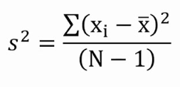
Types of Variation /Dispersion
Variance
Standard deviation
Range
Variance=
x
1
2
3
4
5
First Name | Age
Derek | 18
Daisy | 28
Frederick | 22
Patrick | 20
Sophia | 26
Variance is a statistical measurement that is used to determine the spread of numbers in a data set with respect to the average value or the mean.
Standard deviation is a metric that expresses how dispersed/distribution the observations in a dataset are
Amy | 31
Tony | 38
Daniel | 40
Maximilian | 38
Lana | 37
When is variance is zero?

Slide 4
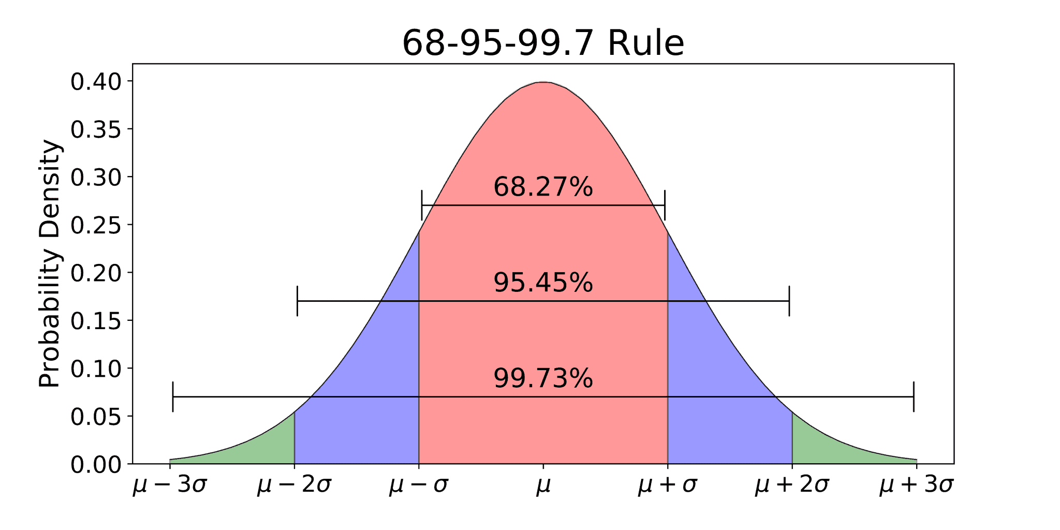

Slide 5
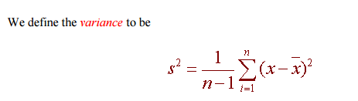
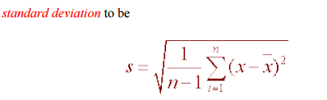

Slide 6



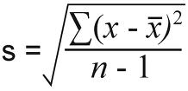
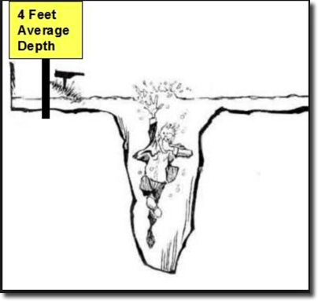
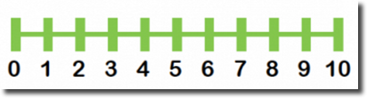
Measures of Dispersion
Dispersion | Population | Sample
1. Variance
2. Standard Deviation
3. Range | Max – Min

Slide 7
Computing step by step
Variance and Standard Deviation: Step by Step
Calculate the mean, x.
Write a table that subtracts the mean from each observed value.
Square each of the differences.
Add this column.
Divide by n -1 where n is the number of items in the sample This is the variance.
To get the standard deviation we take the square root of the variance.

Slide 8
In class exercise
Find Variance, Standard Deviation and Range for
44, 50, 38, 96, 42, 47, 40, 39, 46, 50

Slide 9
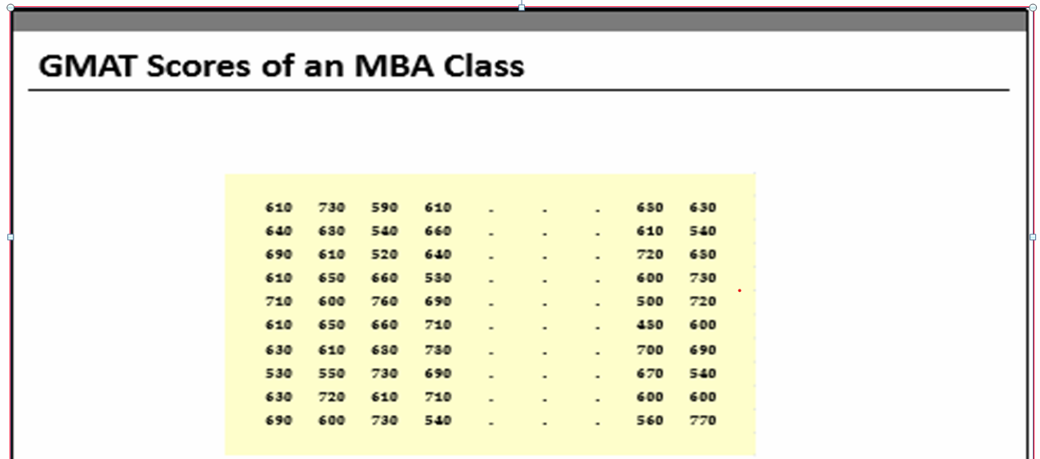
Visualization Techniques

Slide 10
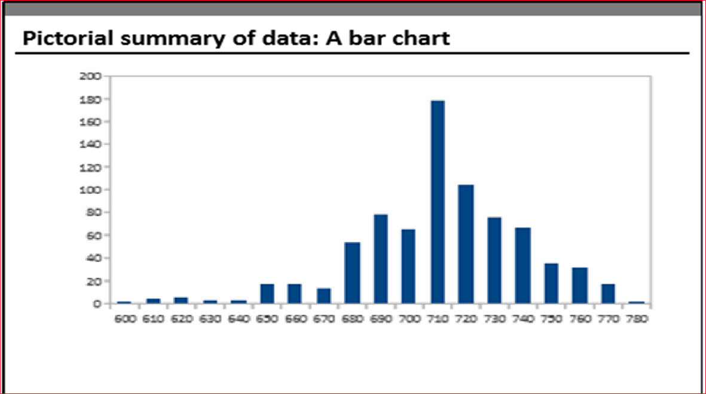

Slide 11
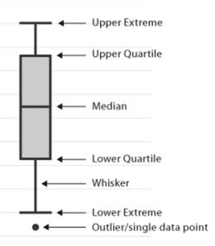
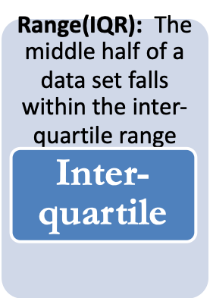

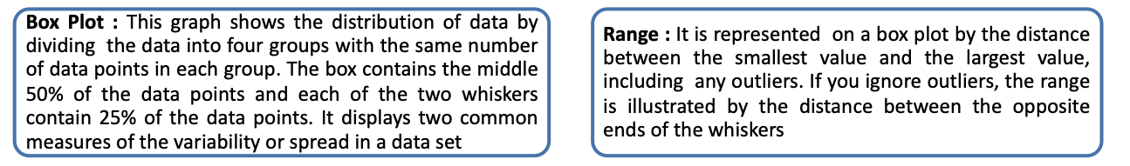
Graphical Techniques – Box Plot

Slide 12
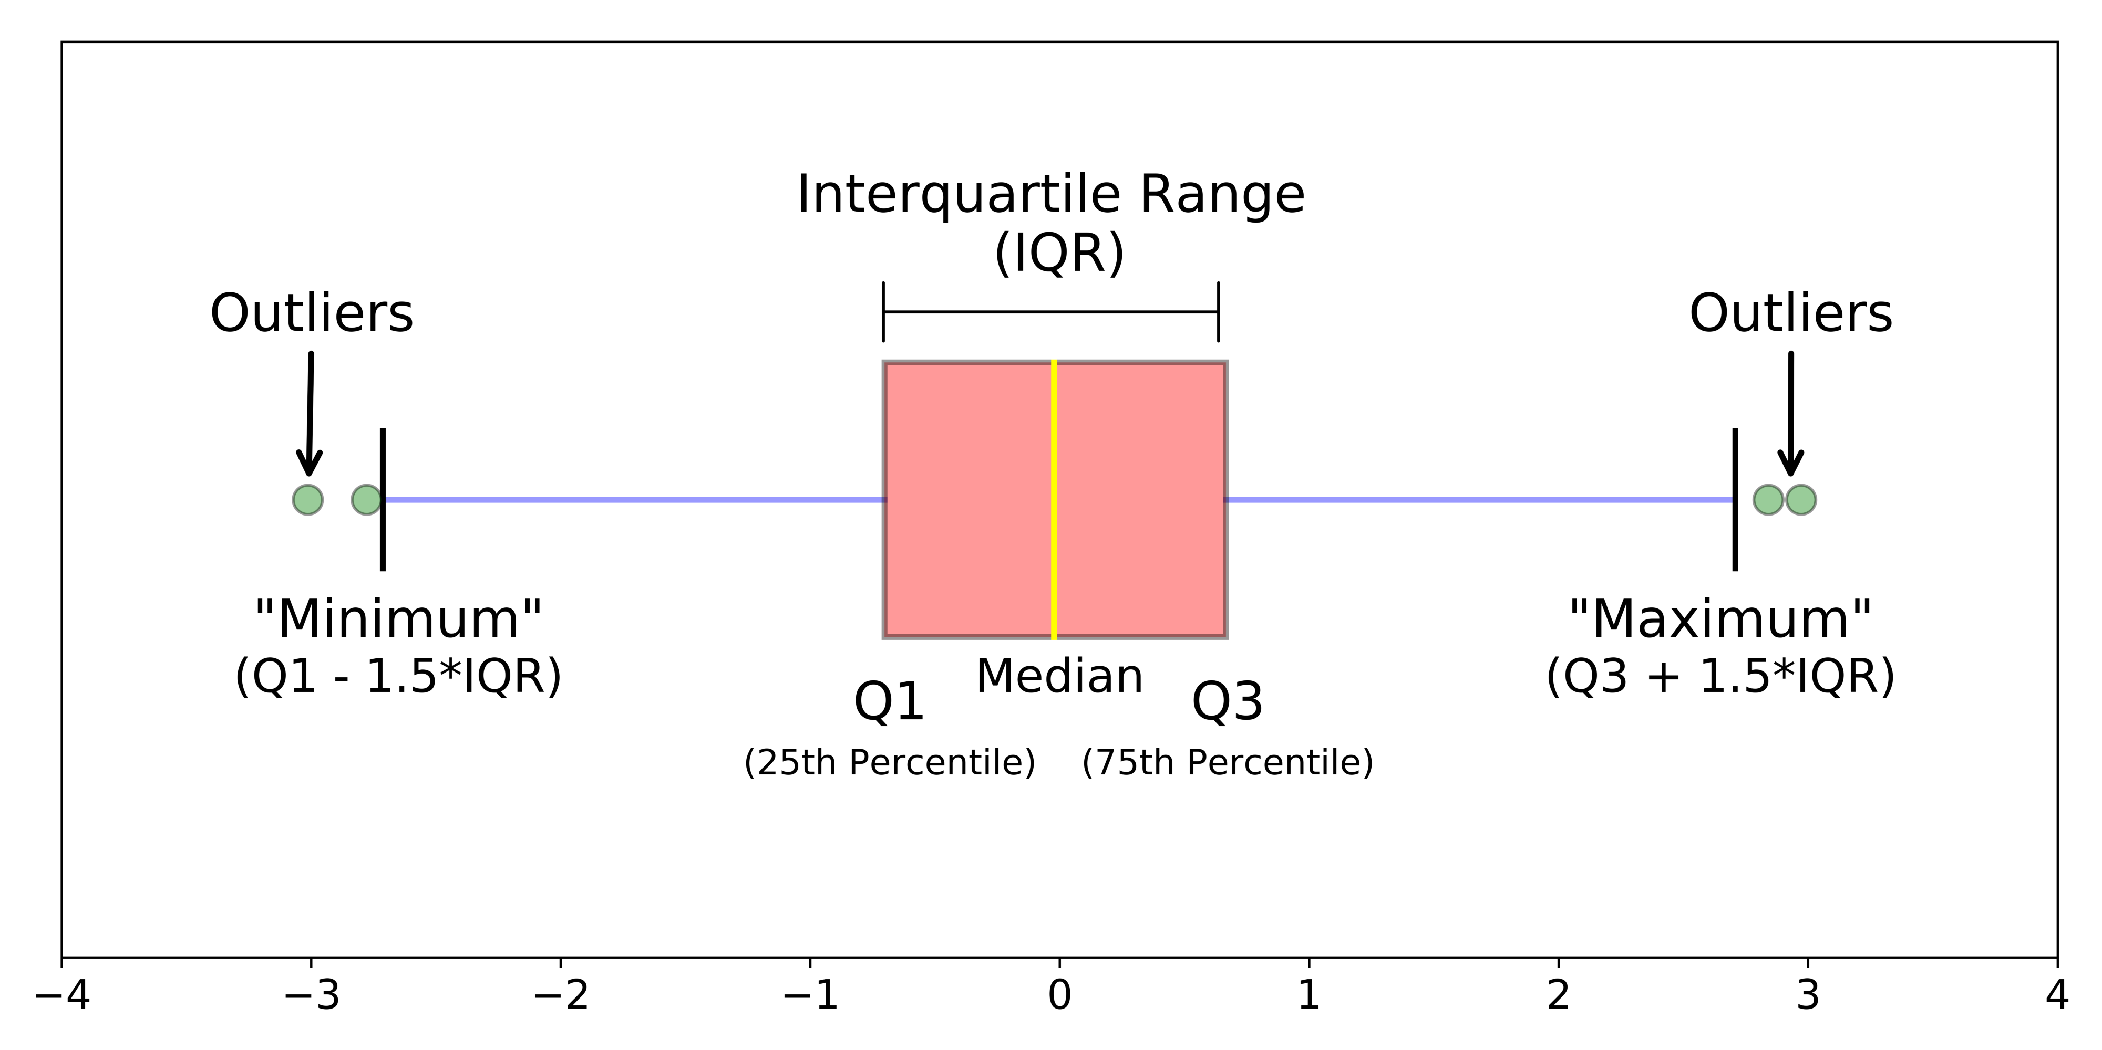

Slide 13
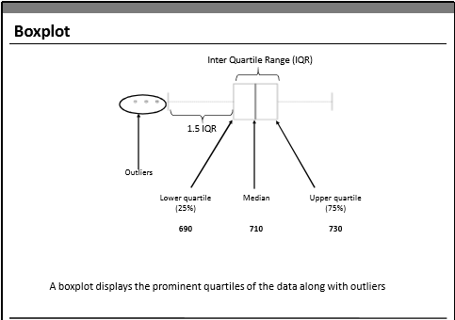

Slide 14
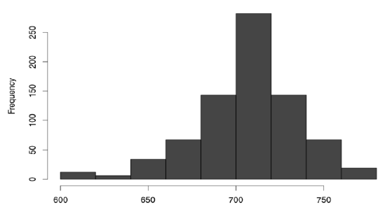
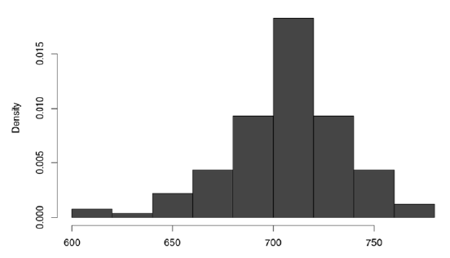
Graphical Techniques – Histogram
A Histogram Represents the frequency distribution, i.e., how many observations take the value within a certain interval.

Slide 15
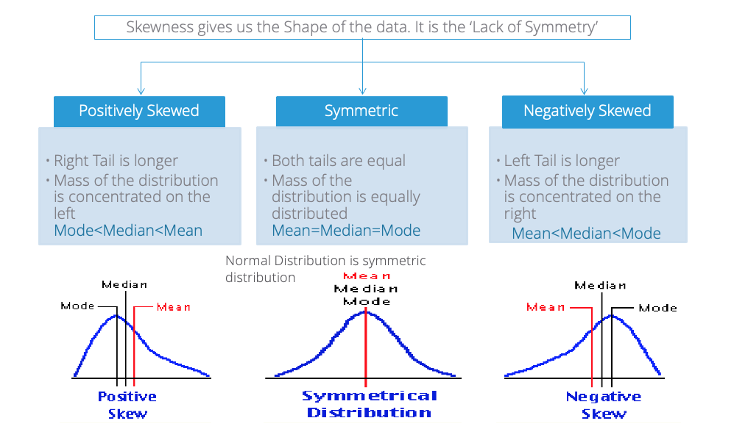


Skewness and Kurtosis
Since the mode is difficult to estimate
The next best thing was to use the (approximate) relationship

Slide 16
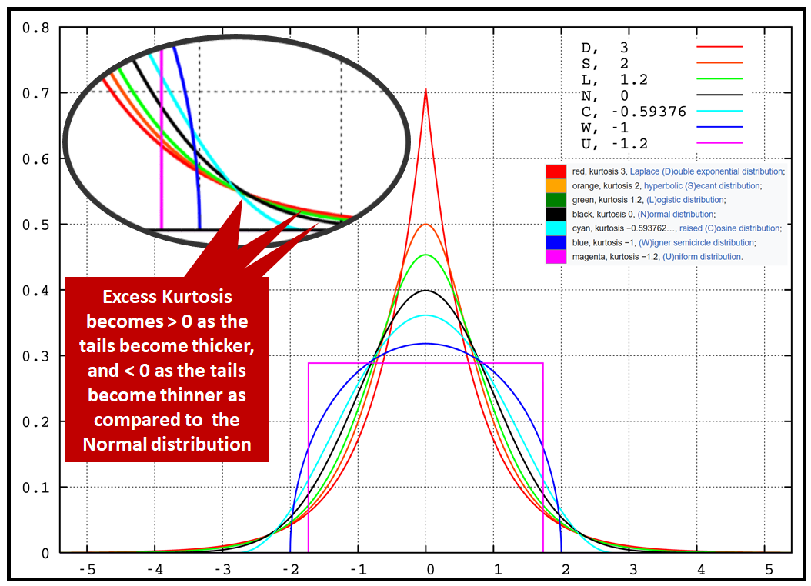
Kurtosis
Its a measure of the tailedness of a distribution. Tailedness is how often outliers occur.

Slide 17
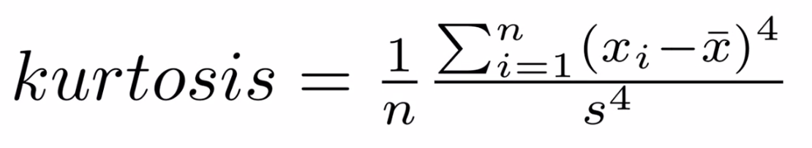
Kurtosis

